Slide 2
Module 4

Slide 3
What Is Apache Spark?
Apache Spark is a unified computing engine and a set of libraries for parallel data processing on computer clusters.
Spark is the most actively developed open source engine for this task, making it a standard tool for any developer or data scientist interested in big data.
Spark supports multiple widely used programming languages (Python, Java, Scala, and R),includes libraries for diverse tasks ranging from SQL to streaming and machine learning.
It runs anywhere from a laptop to a cluster of thousands of servers.

Slide 4
When you think of a “computer,” you think about one machine sitting on your desk at home or at work.
This machine works perfectly well for watching movies or working with spreadsheet software.
However, as many users likely experience at some point, there are some things that your computer is not powerful enough to perform.
One particularly challenging area is data processing.
Single machines do not have enough power and resources to perform computations on huge amounts of information.
A cluster, or group, of computers, pools the resources of many machines together, giving us the ability to use all the cumulative resources as if they were a single computer.
Now, a group of machines alone is not powerful, you need a framework to coordinate work across them.
Spark does just that, managing and coordinating the execution of tasks on data across a cluster of computers.
The cluster of machines that Spark will use to execute tasks is managed by a cluster manager like Spark’s standalone cluster manager, YARN, or Mesos.
We then submit Spark Applications to these cluster managers, which will grant resources to our application so that we can complete our work.

Slide 5
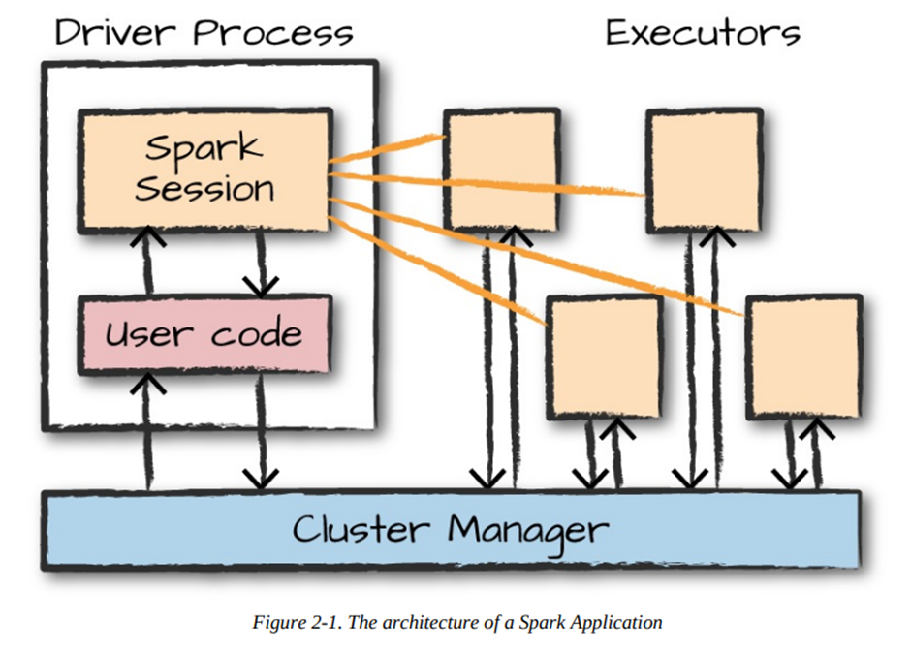
Spark Applications

Slide 6
Spark’s Language APIs
Spark’s language APIs make it possible for you to run Spark code using various programming languages.
Spark has two fundamental sets of APIs: the low-level “unstructured” APIs, and the higher-level structured APIs.
Scala: Spark is primarily written in Scala, making it Spark’s “default” language.
Java: Even though Spark is written in Scala, Spark’s authors have been careful to ensure that you can write Spark code in Java.
Python: Python supports nearly all constructs that Scala supports.
SQL: Spark supports a subset of the ANSI SQL 2003 standard. This makes it easy for analysts and non-programmers to take advantage of the big data powers of Spark.
R: Spark has two commonly used R libraries: one as a part of Spark core(use apache spark framework) (SparkR) and another as an R community-driven package (sparklyr)(is an open-source and modern interface to scale data science and machine learning workflows using Apache Spark).

Slide 7
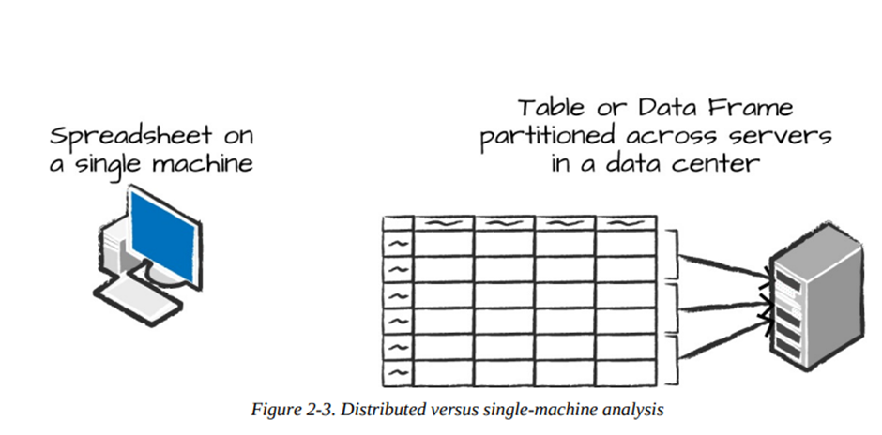
DataFrame
A DataFrame is the most common Structured API and simply represents a table of data with rows and columns.
The DataFrame concept is not unique to Spark. R and Python both have similar concepts.
However, Python/R DataFrames (with some
exceptions) exist on one machine rather than multiple
machines.
This limits what you can do with a given DataFrame
to the resources that exist on that specific machine.
However, because Spark has language interfaces for
both Python and R, it’s quite easy to convert Pandas
(Python) DataFrames to Spark DataFrames, and R DataFrames to Spark DataFrames.

Slide 8
In Apache Spark, a DataFrame is a kind of table where you can perform various operations.
One important thing to know is that DataFrames are immutable.
This means once you create a DataFrame, you can't change it directly.
Instead, you create new DataFrames based on transformations of the original one.
To get the data you want, you write down instructions on how you want to change the DataFrame.
For example, if you want to find all even numbers in a DataFrame called ‘myRange’, you write a transformation that specifies this.
val divisBy2 = myRange.where("number % 2 = 0")
or
divisBy2 = myRange.where("number % 2 = 0")
After you write down these instructions (transformations), you won’t see any immediate output. That’s because Spark doesn’t actually perform these changes right away. It just remembers your instructions.

Slide 9
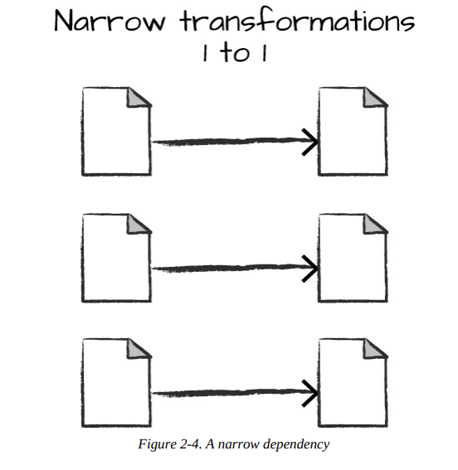
To see the results of your transformations, you need to tell Spark to perform them by using an action. Actions are commands that trigger the computation and return results.
For example, if you wanted to see the even numbers, you might use an action like show() to display the results.
Types of Transformations:
Narrow Transformations:
Each input partition will contribute to only one output partition.
Also known as Pipelining.
Example : You have a stack of papers, and you want to sort them by color.
You first filter out all the blue papers, and then from the remaining papers, you filter out the red ones.
Since each filtering step only looks at the papers you’ve already filtered, you can do these operations one after the other without needing to shuffle or rearrange the papers. This is called pipelining.

Slide 10
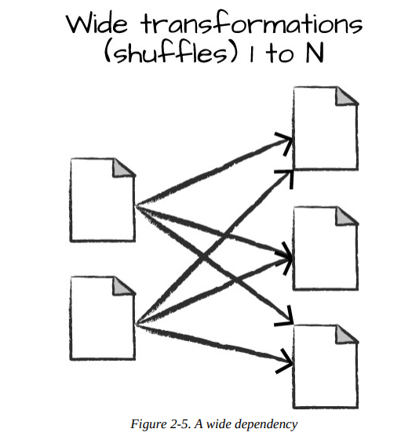
Wide Transformations:
Each input partitions contributing to many output partitions.
Shuffling
Example: Now imagine you need to sort the papers by the size of each paper into different bins (e.g., small, medium, large).
The papers from different stacks need to be combined into these size bins. So, you might need to take papers from all over the place and put them into the correct size bins.
To do this, you have to exchange papers between stacks and rearrange them. This is like a shuffle in Spark. The papers are moved around and written into new bins. Because of this, it’s a more time-consuming process compared to filtering (narrow transformation).

Slide 11
Disadvantages of Transformation
Efficiency: It can combine multiple narrow transformations into one operation, reducing the amount of work needed.
Shuffles: Wide transformations (which involve shuffling data) are more expensive and time-consuming. By delaying execution, Spark can minimize unnecessary shuffling and make the process more efficient.

Slide 12
Lazy Evaluation
Lazy evaluation in Spark means that it doesn't execute your operations immediately.
Instead, when you apply transformations to your data, Spark builds a plan of what you want to do.
It waits until the very end, just before it actually needs the result, to execute this plan.
Spark can optimize the plan to run as efficiently as possible across all the machines in the cluster.
In Spark, "predicate pushdown" is an optimization technique. Imagine you have a large dataset and you only need one specific row.
Even if you specify this filter at the end of a long sequence of operations, Spark is smart enough to figure out that it doesn't need to process the entire dataset.
Instead, it automatically moves the filter to the beginning of the process, so it fetches only that one row from the start. This makes the operation much faster and more efficient.

Slide 13
Actions
Transformations allow us to build up our logical transformation plan. To trigger the computation, we run an action.
An action instructs Spark to compute a result from a series of transformations.
The simplest action is count, which gives us the total number of records in the DataFrame:
divisBy2.count()
Of course, count is not the only action. There are three kinds of actions:
Actions to view data in the console
Actions to collect data to native objects in the respective language
Actions to write to output data sources

Slide 14
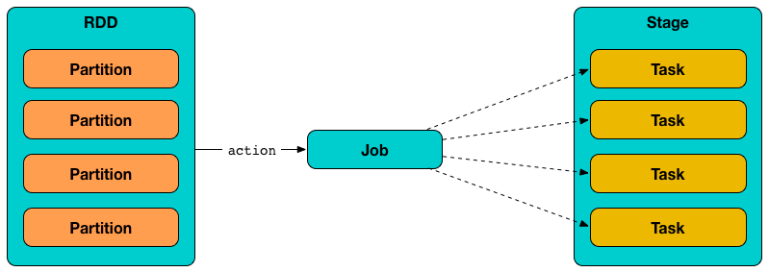
Partitions
To allow every executor to perform work in
parallel, Spark breaks up the data into chunks called
partitions.
A partition is a collection of rows that sit on one physical machine in your cluster. A DataFrame’s partitions represent how the data is physically distributed across the cluster of machines during execution.
If you have one partition, Spark will have a parallelism of only one, even if you have thousands of executors.
If you have many partitions but only one executor, Spark will still have a parallelism of only one because there is only one computation resource.
An important thing to note is that with DataFrames you do not (for the most part) manipulate partitions manually or individually.
You simply specify high-level transformations of data in the physical partitions, and Spark determines how this work will actually execute on the cluster.

Slide 15
Overview of Structured API Execution
This will explain how this code is actually executed across a cluster.
Write DataFrame/Dataset/SQL Code.
If valid code, Spark converts this to a Logical Plan.
Spark transforms this Logical Plan to a Physical Plan, checking for optimizations along the way.
Spark then executes this Physical Plan (RDD :resilient distributed dataset manipulations) on the cluster.

Slide 16
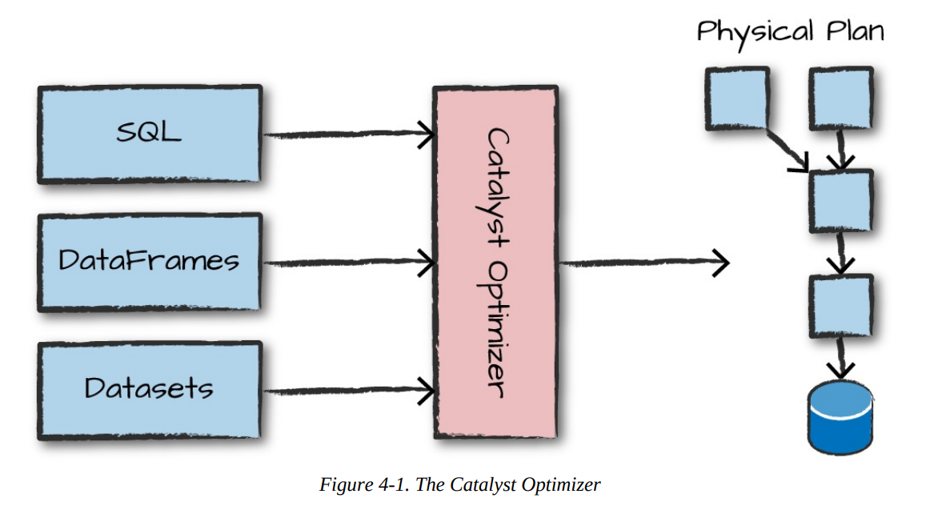
To execute code, we must write code.
This code is then submitted to Spark either through the console or via a submitted job.
This code then passes through the Catalyst Optimizer, which decides how the code should be executed and lays out a plan for doing so before, finally, the code is run and the result is returned to the user.

Slide 17
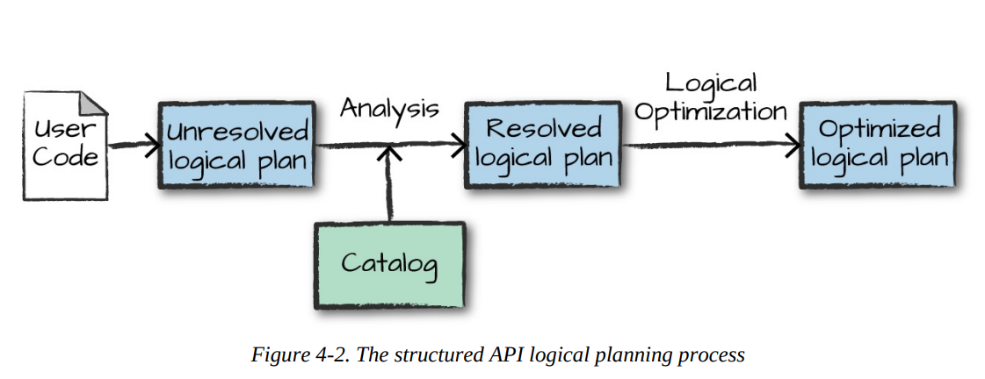
Logical Planning
The first phase of execution is meant to take user code and convert it into a logical plan.

Slide 18
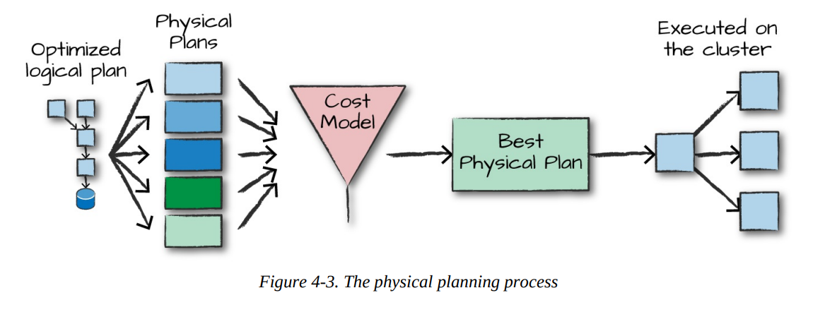
Physical Planning(SPARK Plan)
After successfully creating an optimized logical plan, Spark then begins the physical planning process.

Slide 19
Execution
Upon selecting a physical plan, Spark runs all of this code over RDDs, the lower-level programming interface of Spark.
Spark performs further optimizations at runtime, generating native Java bytecode that can remove entire tasks or stages during execution. Finally the result is returned to the user.

Slide 20
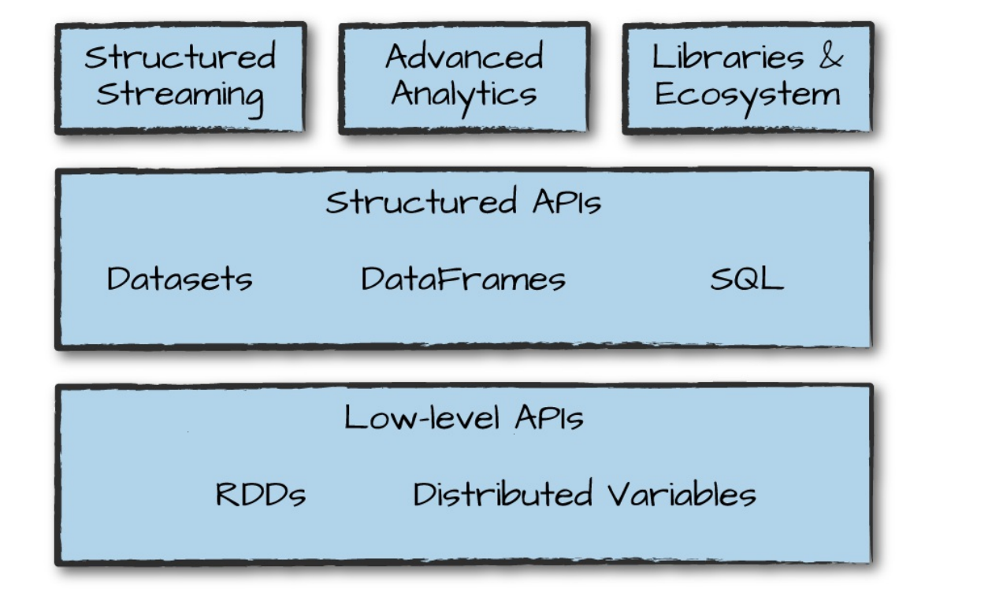
Spark’s Toolset

Slide 21
Datasets: Type-Safe Structured APIs
A type-safe version of Spark’s structured API called Datasets, for writing statically typed code in Java and Scala.
The Dataset API gives users the ability to assign a Java/Scala class to the records within a DataFrame and manipulate it.
The Dataset class is parameterized with the type of object contained inside: Dataset<T> in Java and Dataset[T] in Scala. For example, a Dataset[Person] will be guaranteed to contain objects of class Person.
Flexible Use: You can use Datasets only when you need to. They let you switch between different ways of handling your data.
Combining Methods: You can handle data with specific type-safe methods and then switch to SQL-like queries for more straightforward analysis.

Slide 22
Defining Your Data Type:This creates a Flight class with specific fields. case class Flight(DEST_COUNTRY_NAME: String, ORIGIN_COUNTRY_NAME: String, count: BigInt)
Loading Data: loads flight data into a DataFrame.
val flightsDF = spark.read.parquet("/data/flight-data/parquet/2010-summary.parquet/")
Converting DataFrame to Dataset: converts the DataFrame into a Dataset of type Flight.
val flights = flightsDF.as[Flight]
Filtering and Mapping: filter out rows where the origin country is "Canada", map over the filtered data, and then take the first 5 results.
flights.filter(flight_row => flight_row.ORIGIN_COUNTRY_NAME != "Canada").map(flight_row => flight_row).take(5)
Type Safety: takes the first 5 rows, filters them to exclude flights from "Canada", and then creates new Flight objects with a modified count.
flights.take(5).filter(flight_row => flight_row.ORIGIN_COUNTRY_NAME != "Canada").map(fr => Flight(fr.DEST_COUNTRY_NAME, fr.ORIGIN_COUNTRY_NAME, fr.count + 5))

Slide 23
Structured Streaming
This is a feature in Spark that lets you handle live data (like a stream of updates) in a way that’s similar to how you work with static data (like data in a table).
Seamless Transition: You can use the same code for both batch processing (handling large amounts of data all at once) and streaming (handling data as it comes in). This means you don’t need to write a lot of different code to handle live data.
Reduce Waiting Time: By processing data incrementally (in small chunks as it arrives), you can get results faster compared to processing everything in one big batch.
Easy Prototyping: You can start by writing your data processing as a batch job. Once you have it working, you can easily switch it to handle streaming data.

Slide 24
How Does It Work?
Incremental Processing: Instead of waiting for all data to be collected before processing, Structured Streaming handles small pieces of data as they come in. This way, you get results and insights more quickly.

Slide 25
Machine Learning and Advanced Analytics
Popular aspect of Spark is its ability to perform large-scale machine learning with a built-in library of machine learning algorithms called MLlib.
MLlib is a library in Spark designed for doing machine learning on large amounts of data. Think of it as a toolbox that helps you with various machine learning tasks.

Slide 26
What Can MLlib Do?
Preprocessing: Prepare your data for analysis, like cleaning and organizing it.
Training Models: Use your data to build models that can make predictions or find patterns.
Making Predictions: Use these models to make predictions based on new data.
Integration with Structured Streaming
You can also use MLlib models to make predictions on data as it streams in, meaning you can analyze live data in real time.

Slide 27
Different type of ML can be performed
Classification: Sorting data into categories (like spam or not spam).
Regression: Predicting numerical values (like forecasting sales).
Clustering: Grouping similar data points together (like finding customer segments).
Deep Learning: More complex models for tasks like image recognition.
Example: Clustering with k-means
Clustering is about grouping similar things together.
k-means is a popular algorithm used for clustering. It finds clusters or groups in your data by looking for similarities.

Slide 28
Lower-Level APIs
Spark includes a number of lower-level primitives to allow for arbitrary Java and Python object manipulation via Resilient Distributed Datasets (RDDs).
RDDs (Resilient Distributed Datasets) are a low-level tool in Spark that lets you handle and manipulate data in a distributed manner. They’re like the building blocks of Spark.
DataFrames are a higher-level tool built on top of RDDs. They provide a more user-friendly way to work with data, similar to tables in a database.
You can convert RDDs to DataFrames and vice versa. For example, you can create an RDD with some numbers and then convert it into a DataFrame to use with other DataFrame operations.

Slide 29
Spark’s Ecosystem and Packages
Spark has a big collection of extra tools and packages created by the community.
Variety of Tools: There are over 300 different packages (like add-ons or extra features) available for Spark. These tools help with various tasks and can make working with Spark easier and more powerful.
Growing Collection: New packages are added all the time, so the list keeps getting bigger.
Integration into Spark: Some of these packages become so useful and popular that they get included directly into Spark’s core features over time.

